Slide 1
MACHINE PREDICTIVE MAINTAINENCE
Link- https://www.kaggle.com/shivamb/machine-predictive-maintenance-classification/code
Data- predictive_maintenance

Slide 2
CHALLENGES IN THE PROJECT
No challenges faced.

Slide 3
MAJOR FINDINGS THROUGH EDA
There are many categorical variables and merging has been done.

Slide 4
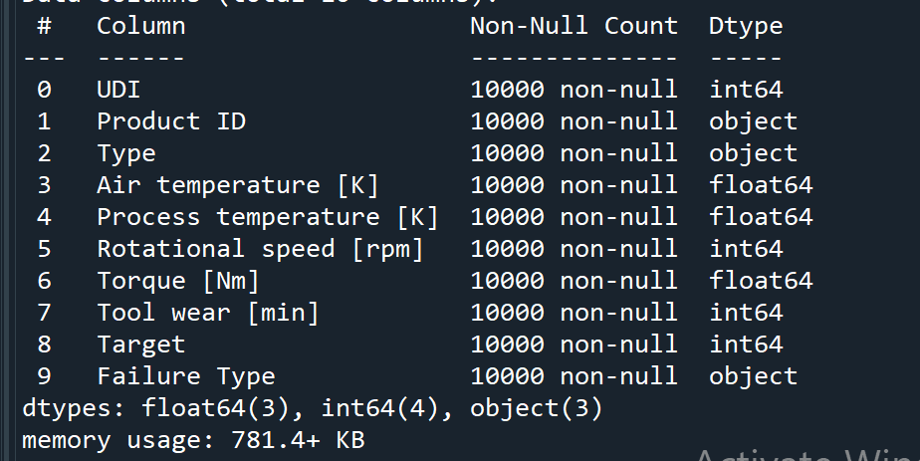
BINARY CLASSIFICATION
Shape- (1000,10)

Slide 5
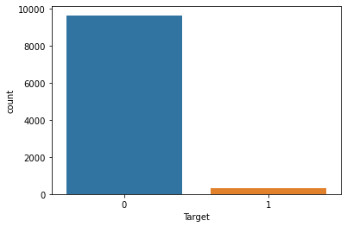
TARGET VARIABLE- ‘Target’
Categorical variable
No null values
0- No failure
1- Failure

Slide 6
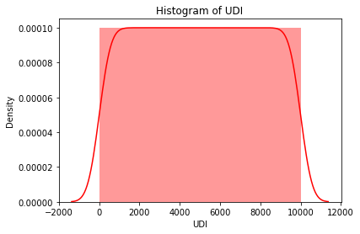
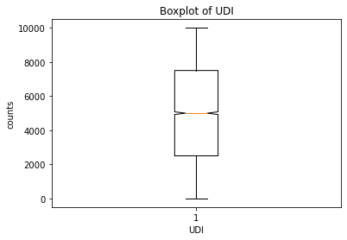
1st Variable- UDI
Continuous variable- No null values
No outliers
This variable was dropped as it had unique values

Slide 7
2nd Variable- Product_ID
Continuous variable
No plots were plotted as it contained strings and is difficult to plot.
This variable was dropped as it had unique values.

Slide 8
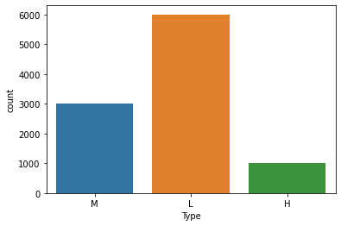
3rd Variable- Type
Categorical Variable (3)
No null values
Merging - M & H

Slide 9
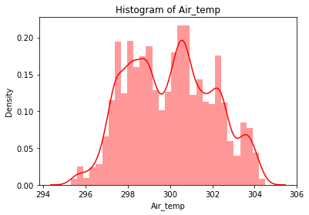
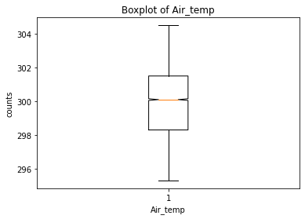
4th Variable - Air_temp
Continuous variable- No null values
No outliers

Slide 10
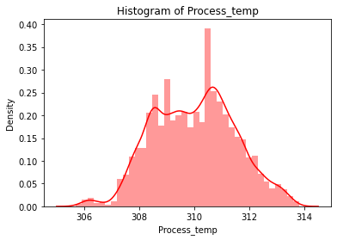
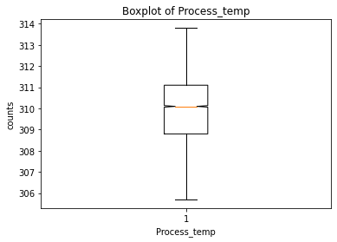
5th Variable- Process_temp
Continuous variable- No null values
No outliers

Slide 11
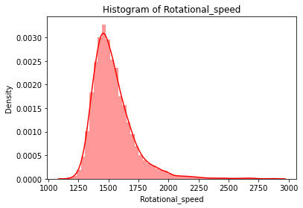
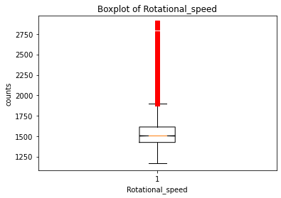
6th Variable- Rotational_speed
Continuous variable- No null values
Outliers (UL) - Treatment done

Slide 12
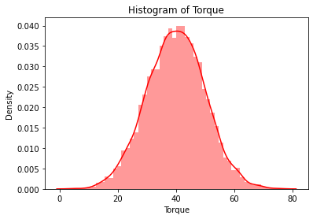
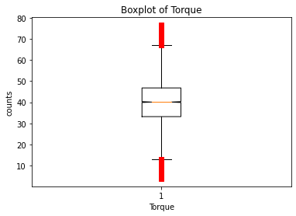
7th Variable- Torque
Continuous variable- No null values
Outliers (UL & LL) - Treatment done

Slide 13
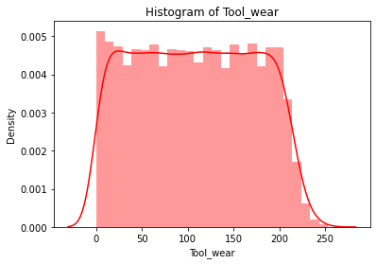
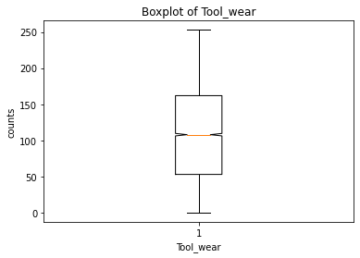
8th Variable- Tool_wear
Continuous variable- No null values
No outliers

Slide 14
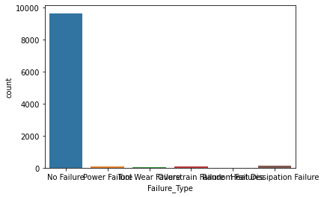
9th Variable- Failure_Type
Categorical variable
No null values
Heat Dissipation Failure
No Failure
Overstrain Failure
Power Failure
Random Failures
Tool Wear Failure
Merging is done

Slide 15
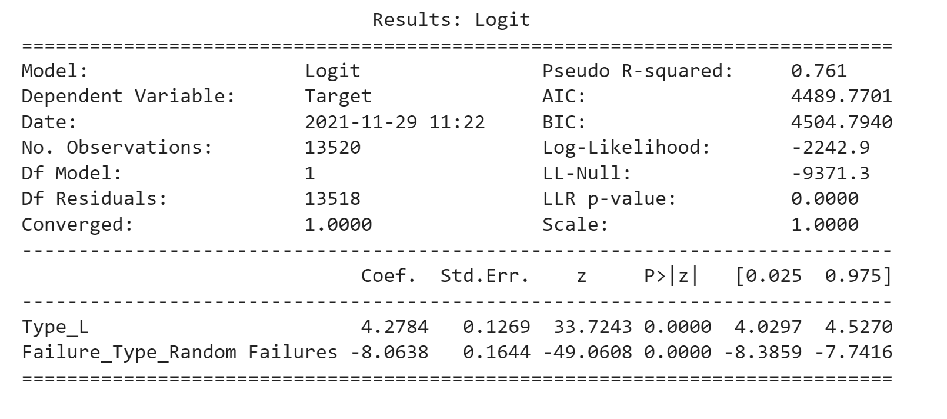
LOGISTIC MODEL BY STATISTIC APPROACH
Recurrsive Feature Elimination- 2

Slide 16
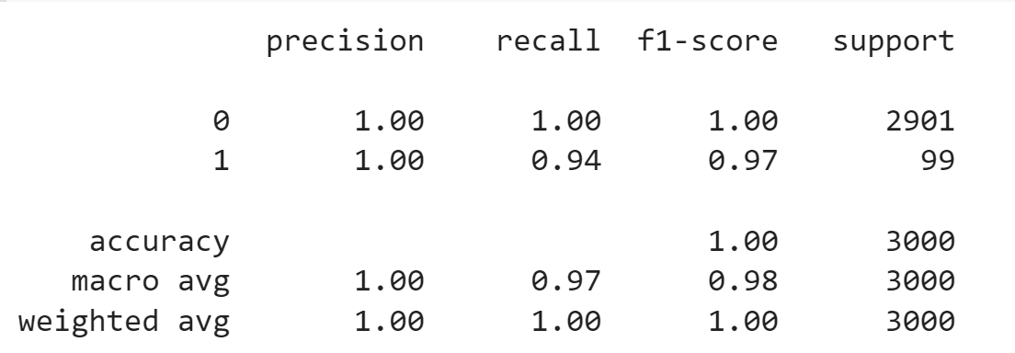
LOGISTIC MODEL BY SK LEARN
print("Accuracy of logistic regression classifier on test data:{}".format(log_score))

Slide 17
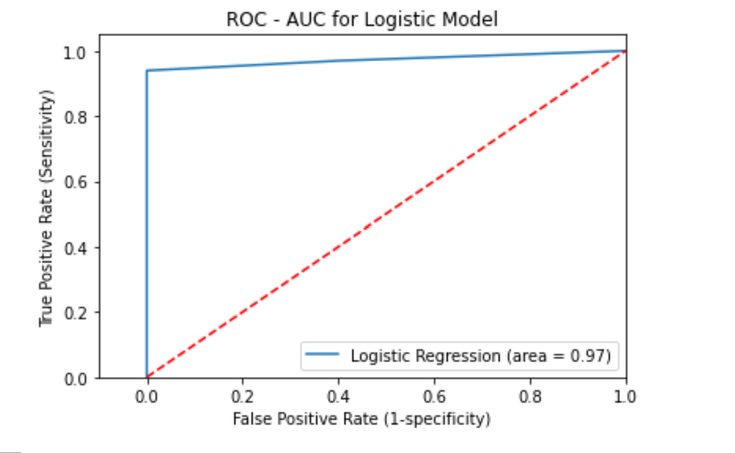
"" Area under curve is 0.96 ""

Slide 18
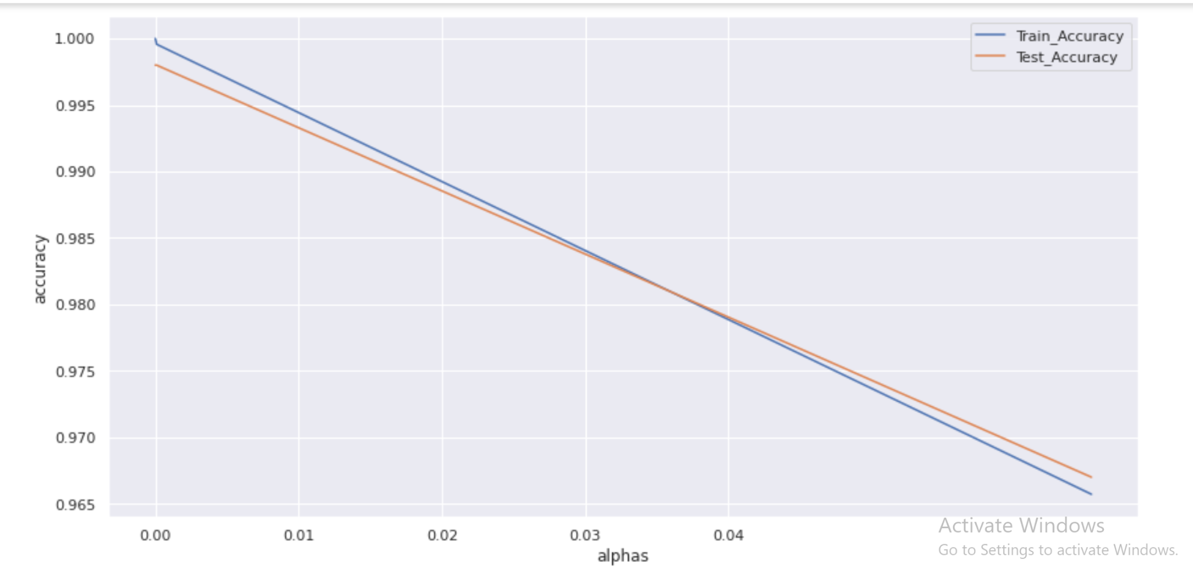
DECISION TREE
Ccp alpha= 0.035

Slide 19
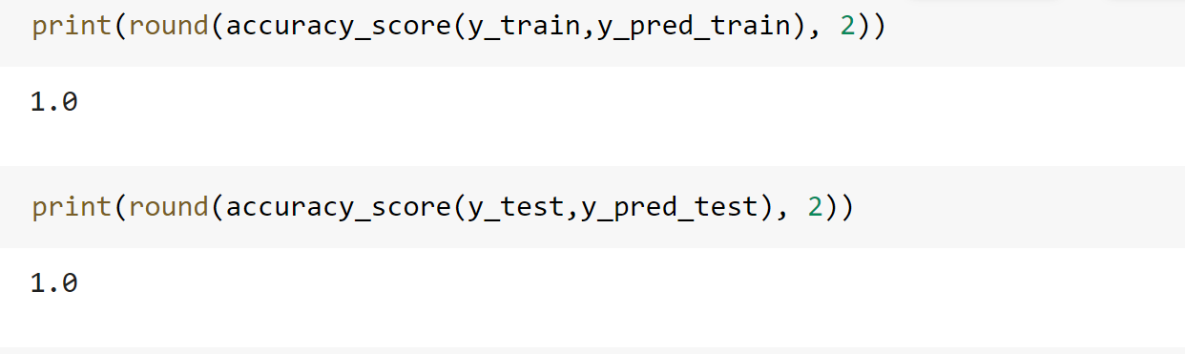

Slide 20
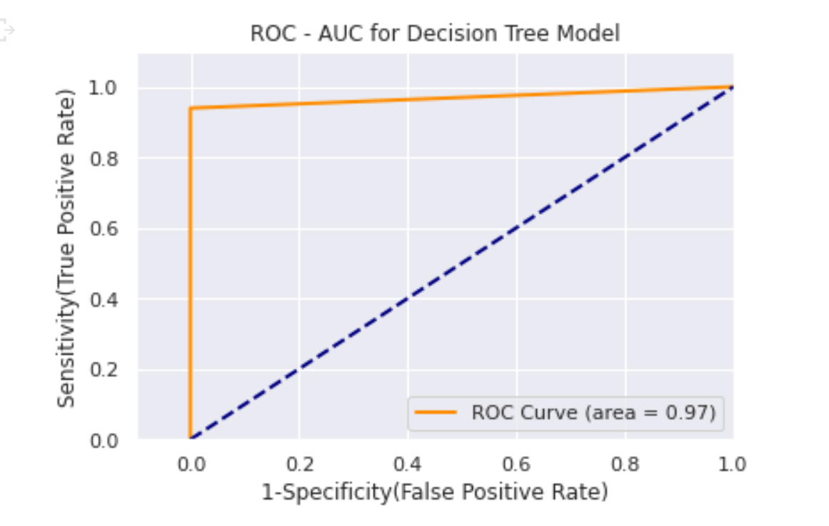

Slide 21
RANDOM FOREST
ACCURACY :-
Train data- 0.97
Test data- 0.97

Slide 22
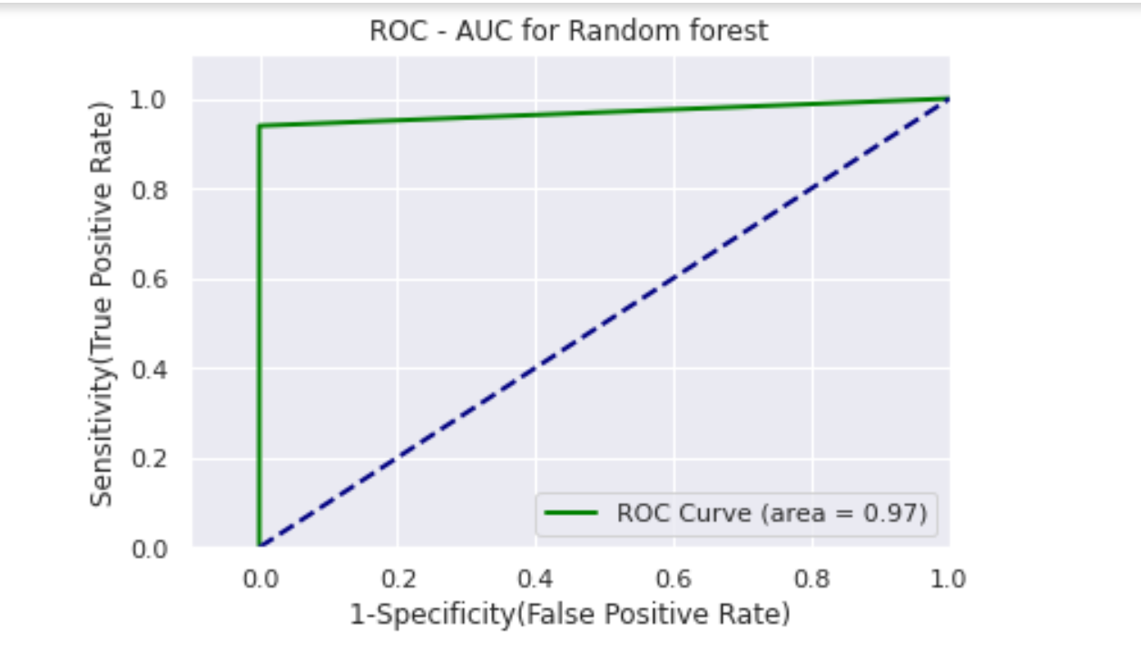
Extract Feature Importance :-
ACCURACY :-
Train data- 1
Test data- 1

Slide 23
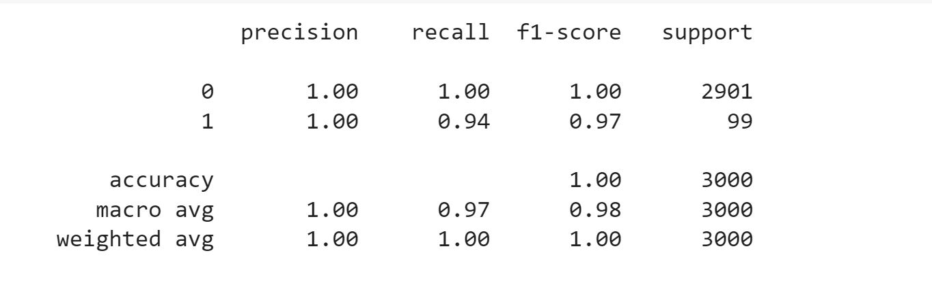
GRADIENT BOOSTING
ACCURACY :-
Train data- 1
Test data- 1

Slide 24
We can see all the models have almost same accuracy. So all the models can be considered as good.

Slide 25
THANK YOU

